Slide 1


What Do We Really See? A Behavioral-Computational Approach to Perceptual Richness
Research Workshop
Naveh Ayal & Itay Yaron
Notes:
You are here to give – not take.

Slide 2
Table of contents
01
Theoretical Background
02
Experimental Paradigm
03
Process Summary
Richness of Consiousness, Cohen et al. (2020, 2021) & Hypothesies
Experimental Design, Fixation Control, Computational Modeling & Predictions
Challenges, Limitations & Next Steps

Slide 3
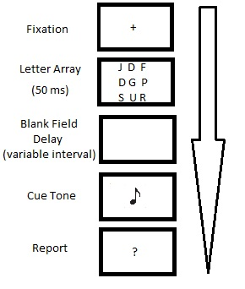
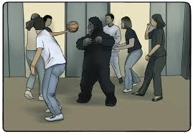
Richness of Consciousness
How much of a visual scene is consciously experienced?
Richness View
Includes more information than we can directly access or report
VS.
Sparse View
Limited to what is actively attended or accessed
Conscious Perception
Example
Notes:
Introduce the topic
The main - Are we truly aware of a richly detailed world, or is our conscious perception far more limited than it feels?
Let's start with the Richness View . This perspective claims that our conscious experience includes much more information than we can directly access or report. Even if we can't describe every detail, the experience itself is rich and full.
Sperling’s partial report paradigm: Participants couldn’t report the whole grid, but could accurately recall any randomly cued row, suggesting their visual experience was much richer than what they could report at once.
On the other side is the Sparse View. This view argues that consciousness is actually limited to what is actively attended or accessed—the rest is outside of awareness.
A classic example here is the gorilla effect, or inattentional blindness. In this experiment, participants are asked to focus on counting basketball passes. Because their attention is narrowly focused, many completely fail to notice a person in a gorilla suit walking through the scene. This phenomenon illustrates that our awareness is not as broad or detailed as we might think—change blindness and inattentional blindness both reveal the limits of what enters consciousness.
So, as we move forward, our research aims to test between these two views: is our visual experience truly rich, or is it actually much sparser than it feels?

Slide 4
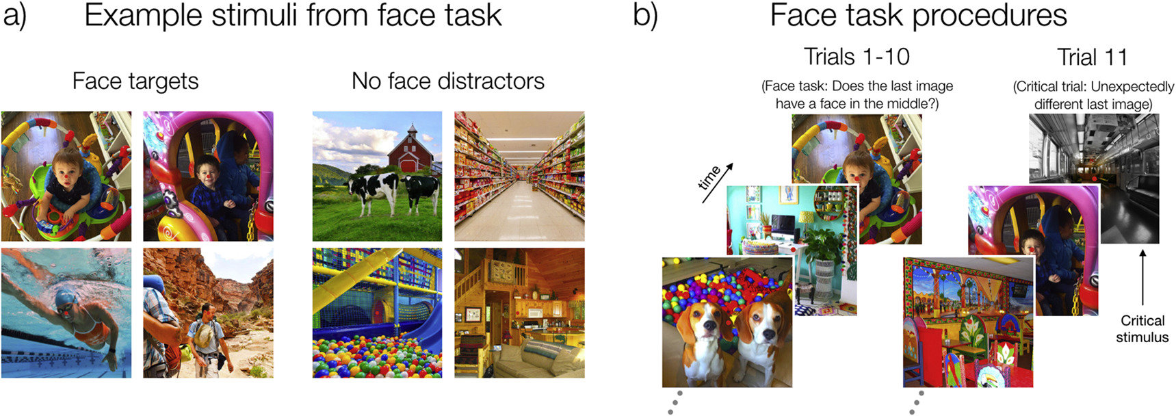
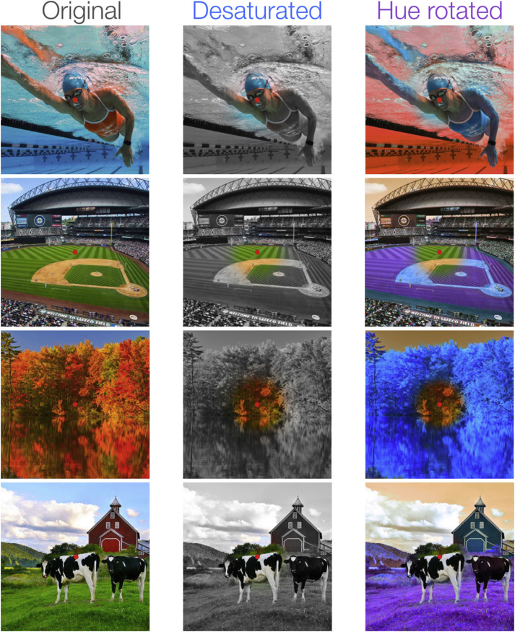
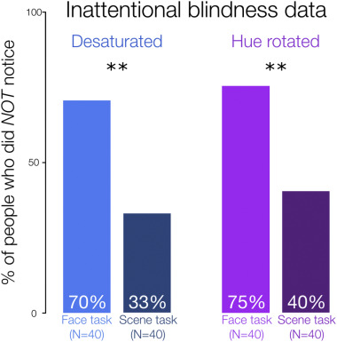
Cohen et al., 2020 (How much color do we see in the blink of an eye?)
RSVP with a central task (face detection/monitored fixation)
Peripheral color was desaturated or hue-rotated on critical trial
(modified inattentional blindness)
Revealed a surprisingly sparse conscious snapshot of color
Supports the sparse view
Notes:
Here’s a great example from Cohen, 2020.
Participants looked for centered faces or made scene judgments while viewing a rapid sequence of images. On the critical trial, we changed the color in the periphery—either desaturating it or rotating the hue—but kept the center unchanged.
The results? Most people didn’t notice anything unusual—even though these changes are dramatic when pointed out! In the face task, about 70–75% missed the color change; with the scene task, still over a third didn’t notice.
The scene task used eye monitoring to the center of the image, yet lower results are still attributed to distributed attention rather than gaze.
This really highlights how limited our conscious perception can be—even for something as basic as color in our visual field

Slide 5
Criticism of Cohen et al. 2020
Ecological Validity: Brief, static image presentations do not capture the dynamic nature of real-world vision
Peripheral Integration: Peripheral color “richness” may accumulate across multiple fixations, which this study does not test
Fixation Verification: No eye-tracking was used in the face task, so central fixation was assumed but not confirmed.
Task Demands: Dividing attention by explicit task instructions may not reflect everyday attentional deployment.

Slide 6
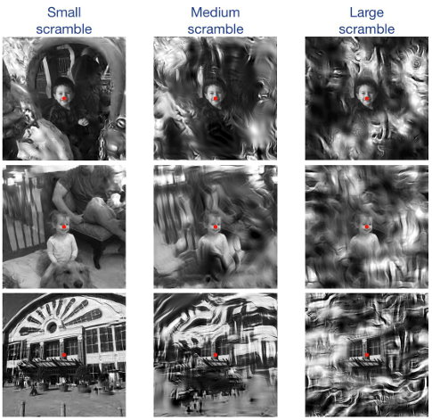
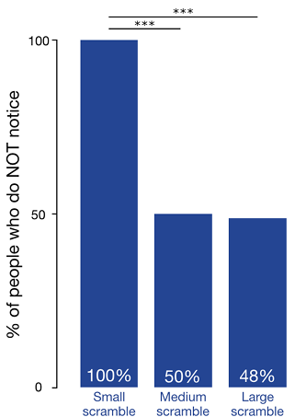
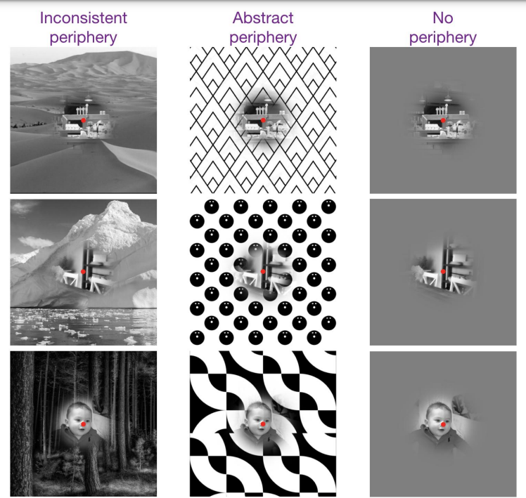
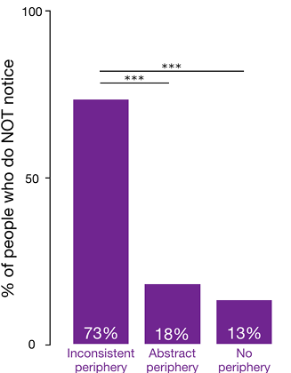
Cohen et al., 2021 (Characterizing a Snapshot of Perceptual Experience)
Same RSVP with a central task (face detection)
Periphery distorted on critical trial (modified inattentional blindness)
Major peripheral scene changes unnoticed during central fixation
Supports the sparse view
Notes:
In the top row, you see the ‘small,’ ‘medium,’ and ‘large’ scramble conditions—these refer to how much of the periphery was scrambled, measured in visual angle. In the small scramble, 2.5° of the image was altered, leaving the central 12.5° untouched. For medium scramble, the central 7.5°, and in the large scramble only the central 2.5° intact.
The bar graph shows that even when nearly the whole periphery was distorted, about half of participants didn’t notice. And when just a thin outer ring was scrambled, almost no one detected it.
The bottom row looks at different kinds of periphery manipulations—replacing the periphery with inconsistent scenes or even abstract patterns. Still, a large majority didn’t notice these dramatic changes, especially when their attention was focused at the center.
This demonstrates that, regardless of how much or how radically the periphery is changed, conscious perception of peripheral content is extremely limited—fitting squarely with the sparse view of visual consciousness.

Slide 7
Criticism of Cohen et al. 2021
Artificial Exposure: Short, non-interactive scene presentations differ from natural viewing experiences
Single Manipulation: Only one unexpected peripheral change per participant may not capture real-world detection abilities
Awareness Measurement: Relying on post-trial questioning may underestimate participants’ true perceptual awareness.
Attention vs. Perception: Even with gaze controlled, completely separating attention from perception is challenging
Generalizability: Findings may not extend to longer exposures or more varied tasks and scenes.
Notes:
In the Context of the Study:
AUC was used to quantify how well neural signals distinguished between "seen" and "unseen" trials.
Impact of Criterion Placement:
Conservative criteria inflated AUC scores because only the clearest "seen" trials were included.
Liberal criteria reduced AUC scores by including ambiguous trials in the "seen" category.

Slide 8
Cohen’s Paradigms
Emphasize what is missed or unnoticed, suggesting perception is sparse
Our Paradigm
Aims to shifts the focus to positively measure
what participants do perceive

Slide 9
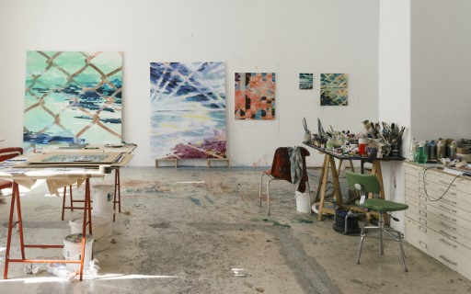
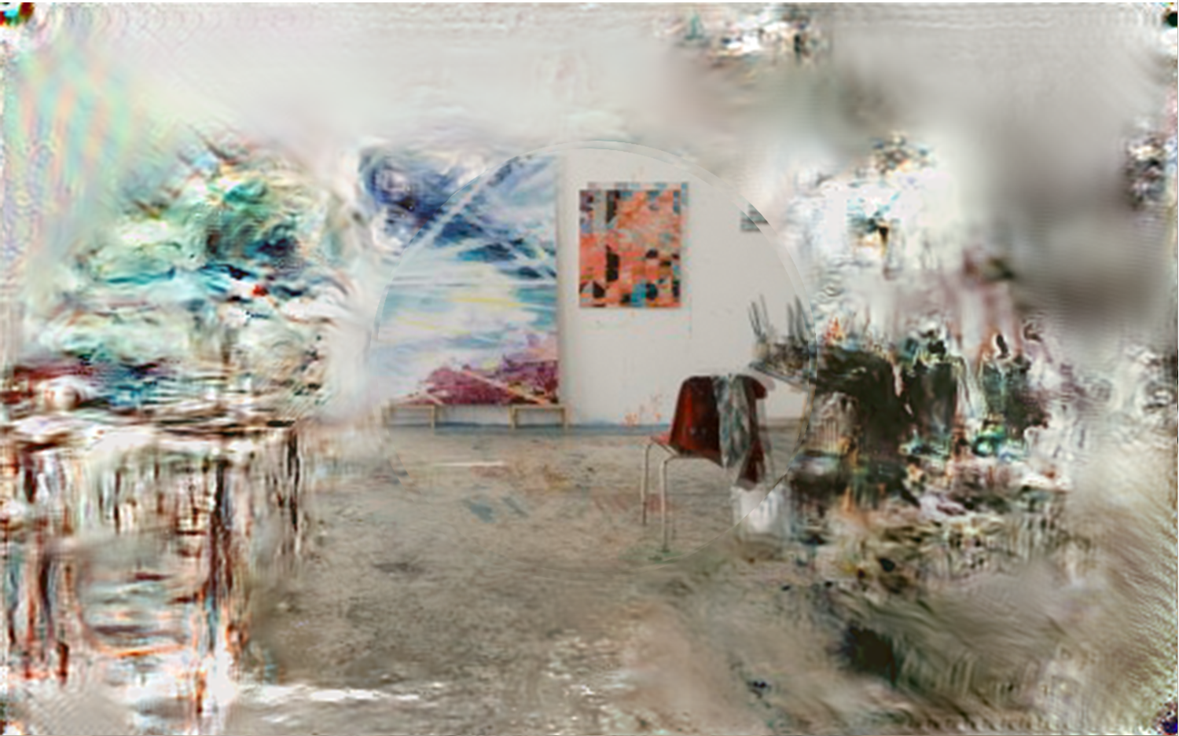
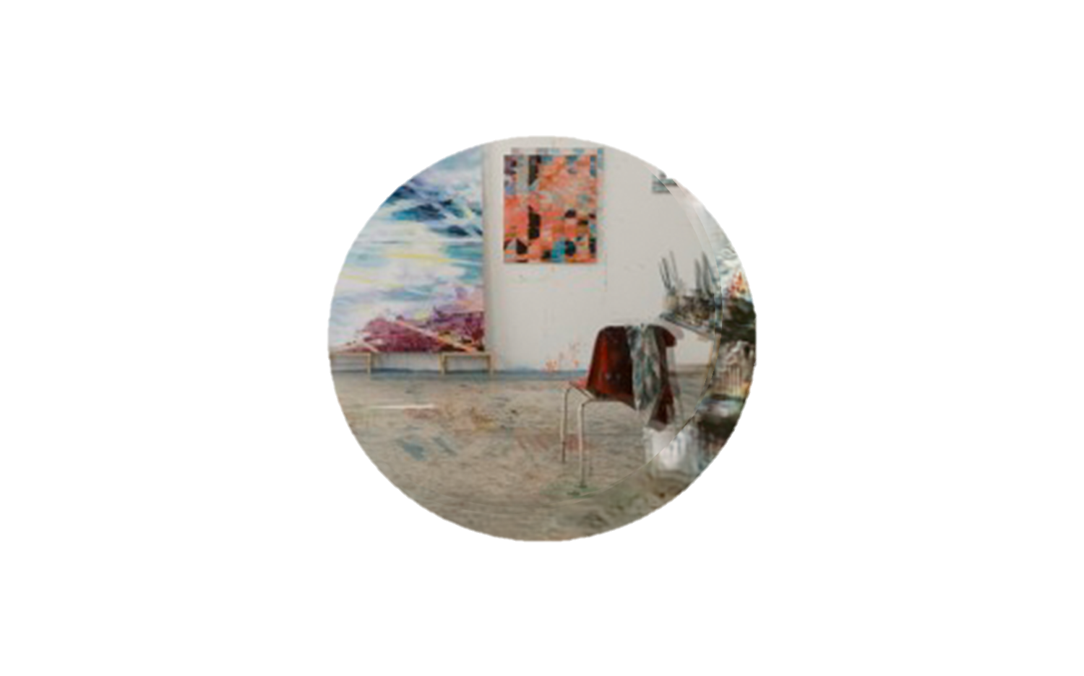
Hypothesies
Research Question:
“Does perception include rich representations of visual periphery?”
Hypothesis 1:
We perceive the entire image
Hypothesis 2:
We perceive some of the peripheral information
Hypothesis 3:
We perceive at the center of attention

Slide 10
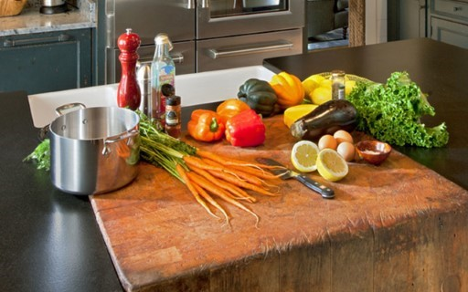
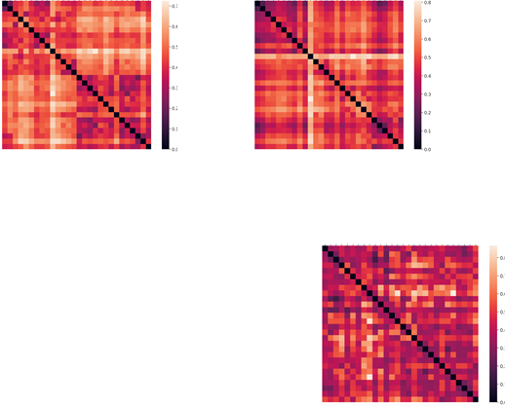
Behavioral-Computational Paradigm
Human similarity ratings
VGG Predictors
“Rich” images
“Sparse” images
“Tunnel” images

Slide 11
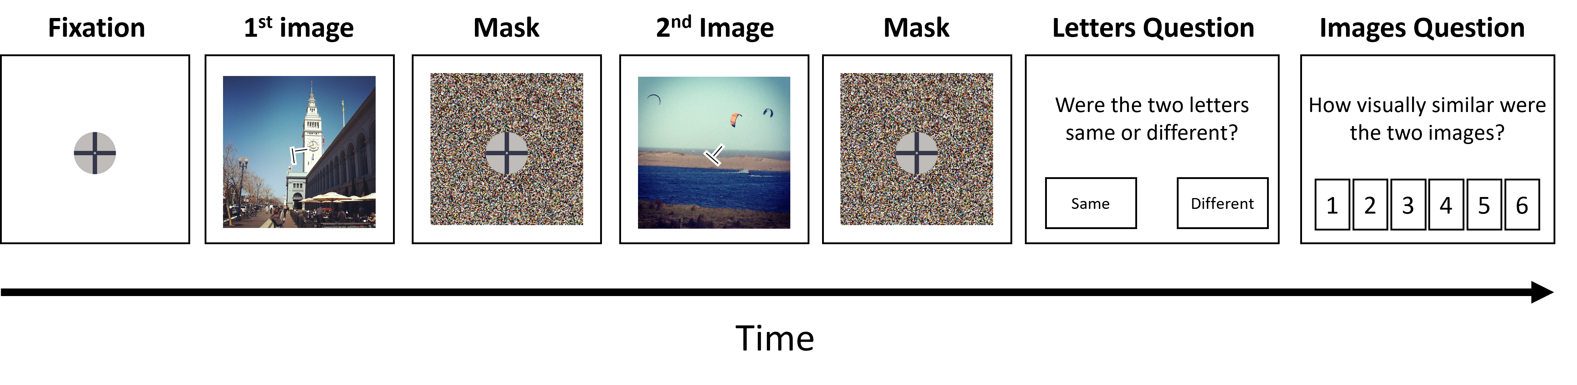
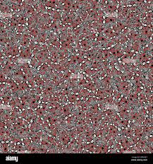
Experimental Design
Sequential Visual Similarity Task with Central Fixation Control
500 ms
288 ms
300 ms
288 ms
300 ms

Slide 12

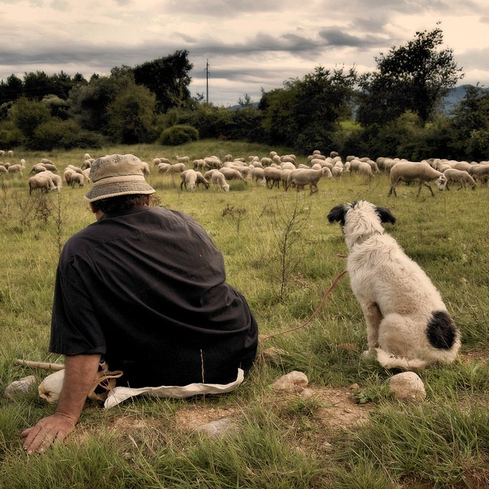
Experimental Design
Methods Overview: Images and Timing
400 images sampled from MS-COCO, : diverse high-level content
Participants will see different pairs, no repetitions
Image size: ~26° visual angle (Cohen et al., 2021)
Duration of 288 ms – “approximately the duration of a single fixation period in naturalistic viewing conditions” (Cohen et al., 2021)
500 ms
288 ms
300 ms
288 ms
300 ms

Slide 13
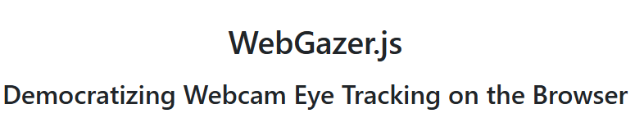
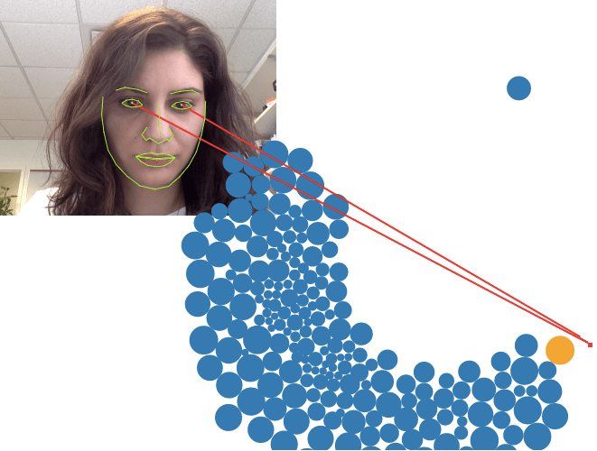
Experimental Design
Fixation – Try 1
Online Eye Tracking Using WebGazer
Webcam eye tracking for fixation – integrated in JsPsych
Ultimately not used due to:
Low spatial accuracy, especially in peripheral vision
Unstable calibration across devices and browsers
Inability to reliably detect 2.5° deviations in real-time
500 ms
288 ms
300 ms
288 ms
300 ms
Notes:
We initially considered using WebGazer, a webcam-based eye tracking tool, to monitor fixation and ensure that participants were looking at the center of the screen.
The goal was to verify that participants weren't moving their eyes during the brief image presentations.
However, in our pilot testing, we found that WebGazer's spatial accuracy wasn't sufficient — especially when it came to reliably detecting deviations of a few degrees in the visual periphery.
The calibration was also unstable across participants, devices, and browsers — which would have introduced more noise than signal.
So we made a deliberate decision to exclude WebGazer from the final version of the experiment.
Instead, we enforced central fixation behaviorally:
Each image was shown for only 133 milliseconds, which is too short for a saccade to occur.
A fixation cross was shown before each image.
A letter discrimination task (T/L) required attention to the center.
A virtual chinrest ensured consistent image scaling across participants.
Together, these controls provided strong fixation enforcement without the unreliability of webcam-based tracking.
So while we originally explored eye tracking, our final design relies on timing, task structure, and behavioral enforcement — which are more robust in this online setting.

Slide 14
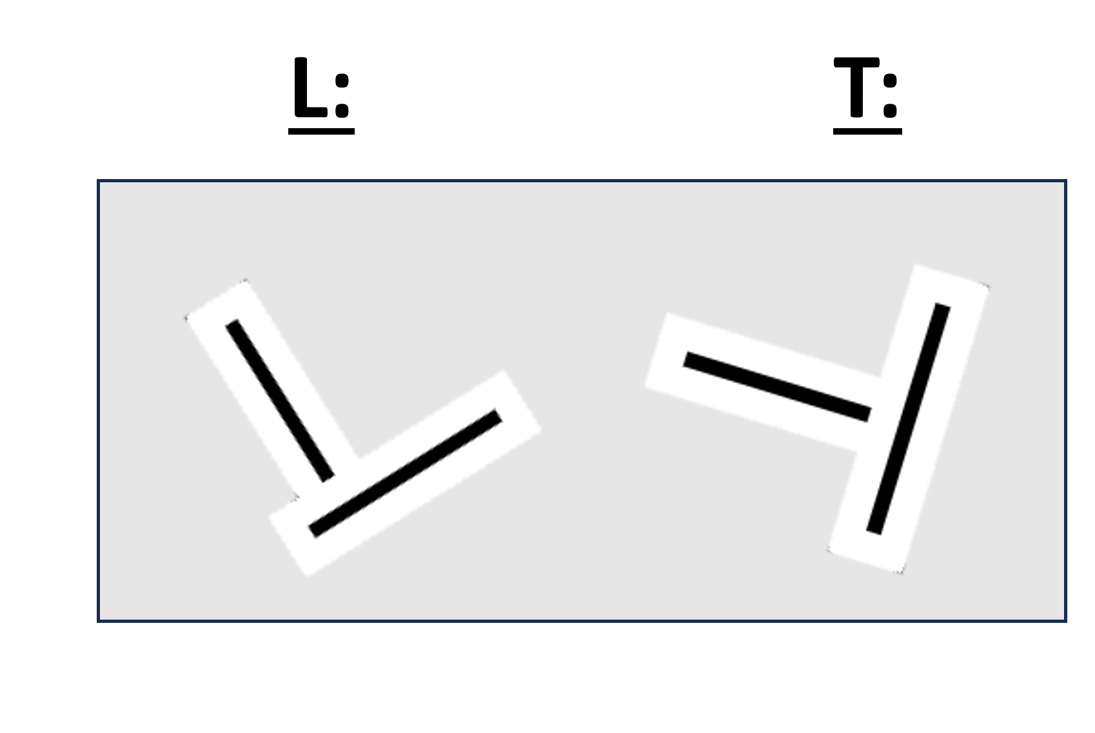
Experimental Design
Fixation – Try 2
Letter Discrimination Task
“Were the two letters same or different?”
T or L letters appear in the center of each image
Random orientations prevent easy guessing
Task ensures attention is maintained at fixation
500 ms
288 ms
300 ms
288 ms
300 ms

Slide 15
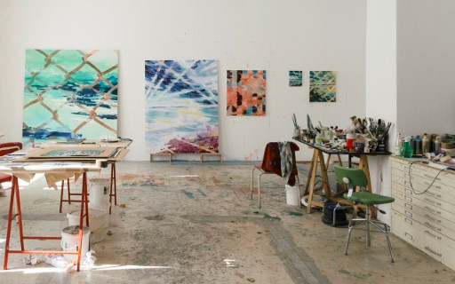
Experimental Design
Main Task - Sequential Similarity
“How visually similar were the two images?”
Participants rate similarity on a 1–6 scale
Response based on perceived visual content
Used to build a behavioral vector of similarity ratings
vs.
500 ms
288 ms
300 ms
288 ms
300 ms
Notes:
Empty catch trial OR black square catch trial

Slide 16

Experimental Design
Pre-Trial Fixation
Holds central gaze
Design taken from *Cogitate
500 ms
288 ms
300 ms
288 ms
300 ms
Notes:
Empty catch trial OR black square catch trial

Slide 17
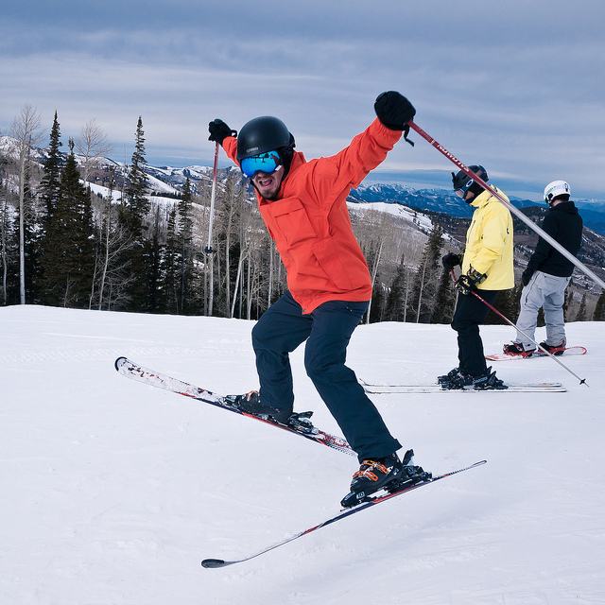
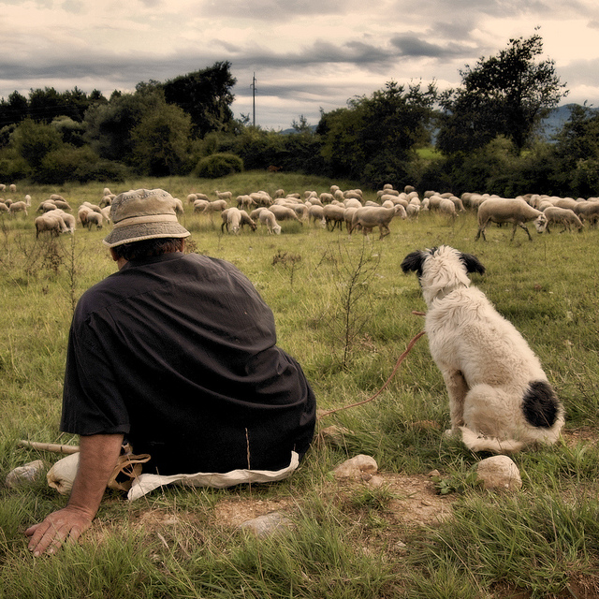
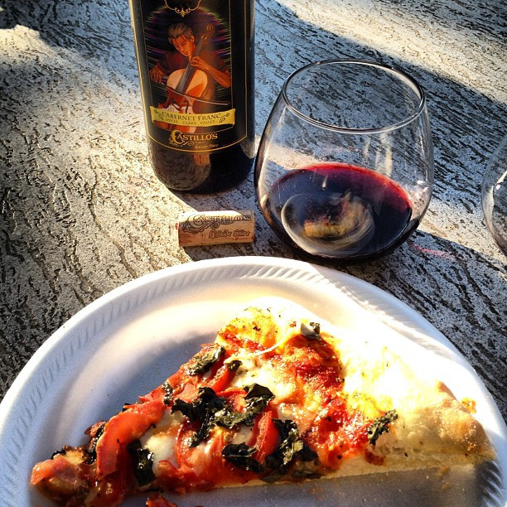
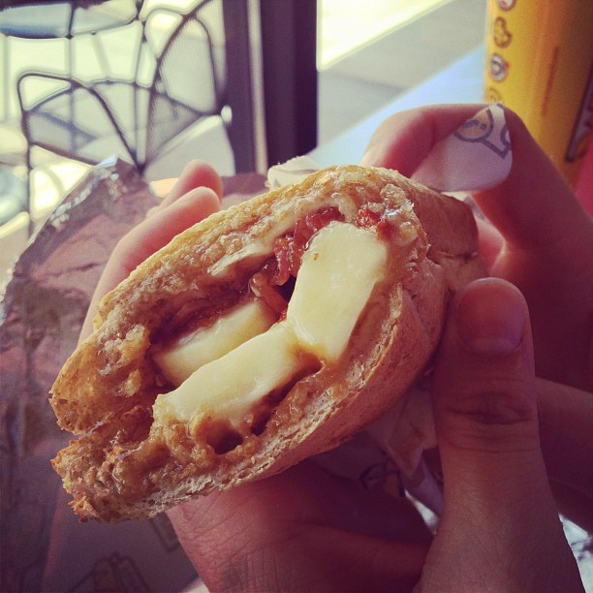
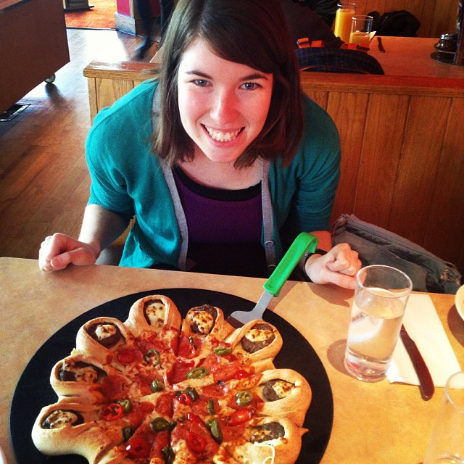
Experimental Design
Masks
Generated from all 400 images
Prevents afterimages and blocks visual persistence
…..
500 ms
288 ms
300 ms
288 ms
300 ms
Notes:
Empty catch trial OR black square catch trial

Slide 18
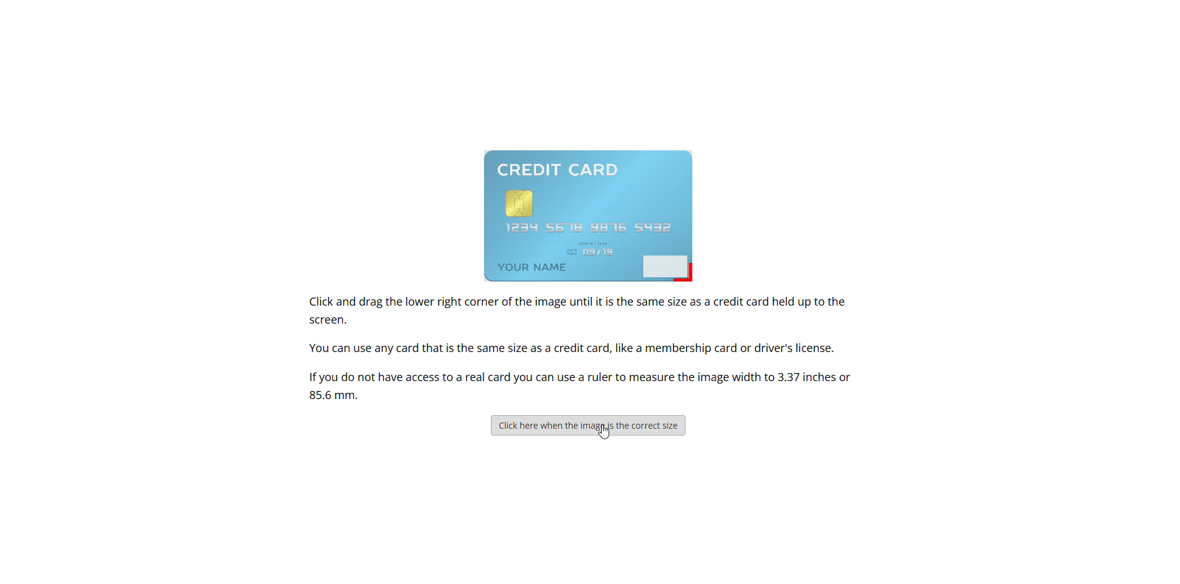
Experimental Design
Demo
Notes:
Empty catch trial OR black square catch trial

Slide 19
Experimental Design
Modeling Perception with VGG
Each image is processed in 3 versions (Cohen et al., 2021):
Rich: Full image (unaltered)
Sparse: center 2.5° preserved & 1.5° gradually blurred, blurred periphery
Tunnel: Only central 2.5°, rest removed
VGG extracts embedding vectors from each version
We then Compute similarity vectors for each version
Correlate model similarity vectors with behavioral similarity vectors

Slide 20
Predictions
Hypothesis 1:
We perceive the entire image
Hypothesis 2:
We perceive some of the peripheral (unattended) information
Hypothesis 3:
We perceive only the center of attention
Notes:
“Here we’re showing the predictions for each of our three hypotheses, and how they would look in terms of correlation between model predictions and human similarity ratings.
On the left is Hypothesis 1: if people perceive the entire image, we’d expect the Rich model—the one that uses the whole, unaltered image in VGG—to show the strongest correlation with behavioral ratings.
In the middle, Hypothesis 2 suggests we perceive some, but not all, peripheral information. In this case, the Sparse model, which blurs the periphery but preserves the center, might show the best match to participants’ ratings.
On the right, Hypothesis 3: if only the central region is perceived, then the Tunnel model—which only keeps the central 2.5 degrees—would correlate best with human judgments.
It’s important to emphasize that here, VGG isn’t meant to embody how the brain actually sees or processes images. Instead, we’re using it as a powerful statistical tool to extract features from the images—features that capture real, discriminative differences in visual content.
By comparing the representational structures generated by VGG for each condition to the structure of human similarity ratings, we can test which hypothesis about conscious perception is most consistent with our data.
In other words, we’re using VGG as a ‘yardstick’ for visual information, not as a model of human perception per se. If a particular VGG-based model correlates highly with human similarity ratings, it suggests that the information preserved in that version of the image is most likely to be consciously perceived.”

Slide 21
Limitations
Single Neural Network
Stimulus Duration (288 ms)
Results might differ with other networks
Might allow eye movements towards periphery
No Direct Eye-Tracking
Ecological Validity - Static Visual Stimuli
Behavioral controls not as precise as eye-tracking
Real-world vision involves dynamic scenes.
Notes:
Talk about how their findings threaten PAS directly as a subjective measure of consciosness

Slide 22
Challenges
Letting go of WebGazer
Controlling Fixation and Visual Angle Online
We had to move on from it due to low accuracy and calibration issues
Maintaining central gaze and consistent stimulus scaling without lab equipment
Balancing Task Difficulty and Attention Control
Making the task harder can enforce central attention, but risks reducing data quality
Notes:
Talk about how their findings threaten PAS directly as a subjective measure of consciosness

Slide 23
Potential Imapct
01
Provides a positive measure of perceptual content
02
Challenges and refines the sparse/rich debate
03
Establishes a scalable behavioral paradigm
→ Moves beyond change/inattentional blindness to ask what is actually seen
→ Data-driven approach to evaluating theories of conscious experience
→ Suitable for large-scale, online testing without lab equipment

Slide 24
Next Steps
Assess whether the letter task affects difficulty or biases similarity judgments
Pilot With/Without Letter Discrimination Task
Finish creating the degraded Stimuli
Complete generation of blurred and tunnel versions for all image, can run in background
Run Experiment & Analyze Results
Run full similarity rating behavioral paradigm
& VGG analysis
Notes:
Talk about how their findings threaten PAS directly as a subjective measure of consciosness

Slide 25
Thank You Questions?
Research Workshop

Slide 26
Instructions for use
If you have a free account, in order to use this template, you must credit Slidesgo by keeping the Thanks slide. Please refer to the next slide to read the instructions for premium users.
As a Free user, you are allowed to:
- Modify this template.
- Use it for both personal and commercial projects.
You are not allowed to:
- Sublicense, sell or rent any of Slidesgo Content (or a modified version of Slidesgo Content).
- Distribute Slidesgo Content unless it has been expressly authorized by Slidesgo.
- Include Slidesgo Content in an online or offline database or file.
- Offer Slidesgo templates (or modified versions of Slidesgo templates) for download.
- Acquire the copyright of Slidesgo Content.
For more information about editing slides, please read our FAQs or visit Slidesgo School:
https://slidesgo.com/faqs and https://slidesgo.com/slidesgo-school

Slide 27
Instructions for use (premium users)
As a Premium user, you can use this template without attributing Slidesgo or keeping the "Thanks" slide.
You are allowed to:
Modify this template.
Use it for both personal and commercial purposes.
Hide or delete the “Thanks” slide and the mention to Slidesgo in the credits.
Share this template in an editable format with people who are not part of your team.
You are not allowed to:
Sublicense, sell or rent this Slidesgo Template (or a modified version of this Slidesgo Template).
Distribute this Slidesgo Template (or a modified version of this Slidesgo Template) or include it in a database or in any other product or service that offers downloadable images, icons or presentations that may be subject to distribution or resale.
Use any of the elements that are part of this Slidesgo Template in an isolated and separated way from this Template.
Register any of the elements that are part of this template as a trademark or logo, or register it as a work in an intellectual property registry or similar.
For more information about editing slides, please read our FAQs or visit Slidesgo School:
https://slidesgo.com/faqs and https://slidesgo.com/slidesgo-school

Slide 28
Fonts & colors used
This presentation has been made using the following fonts:
Old Standard TT
(https://fonts.google.com/specimen/Old+Standard+TT)
Didact Gothic
(https://fonts.google.com/specimen/Didact+Gothic)
#191919
#ddd9d5

Slide 29

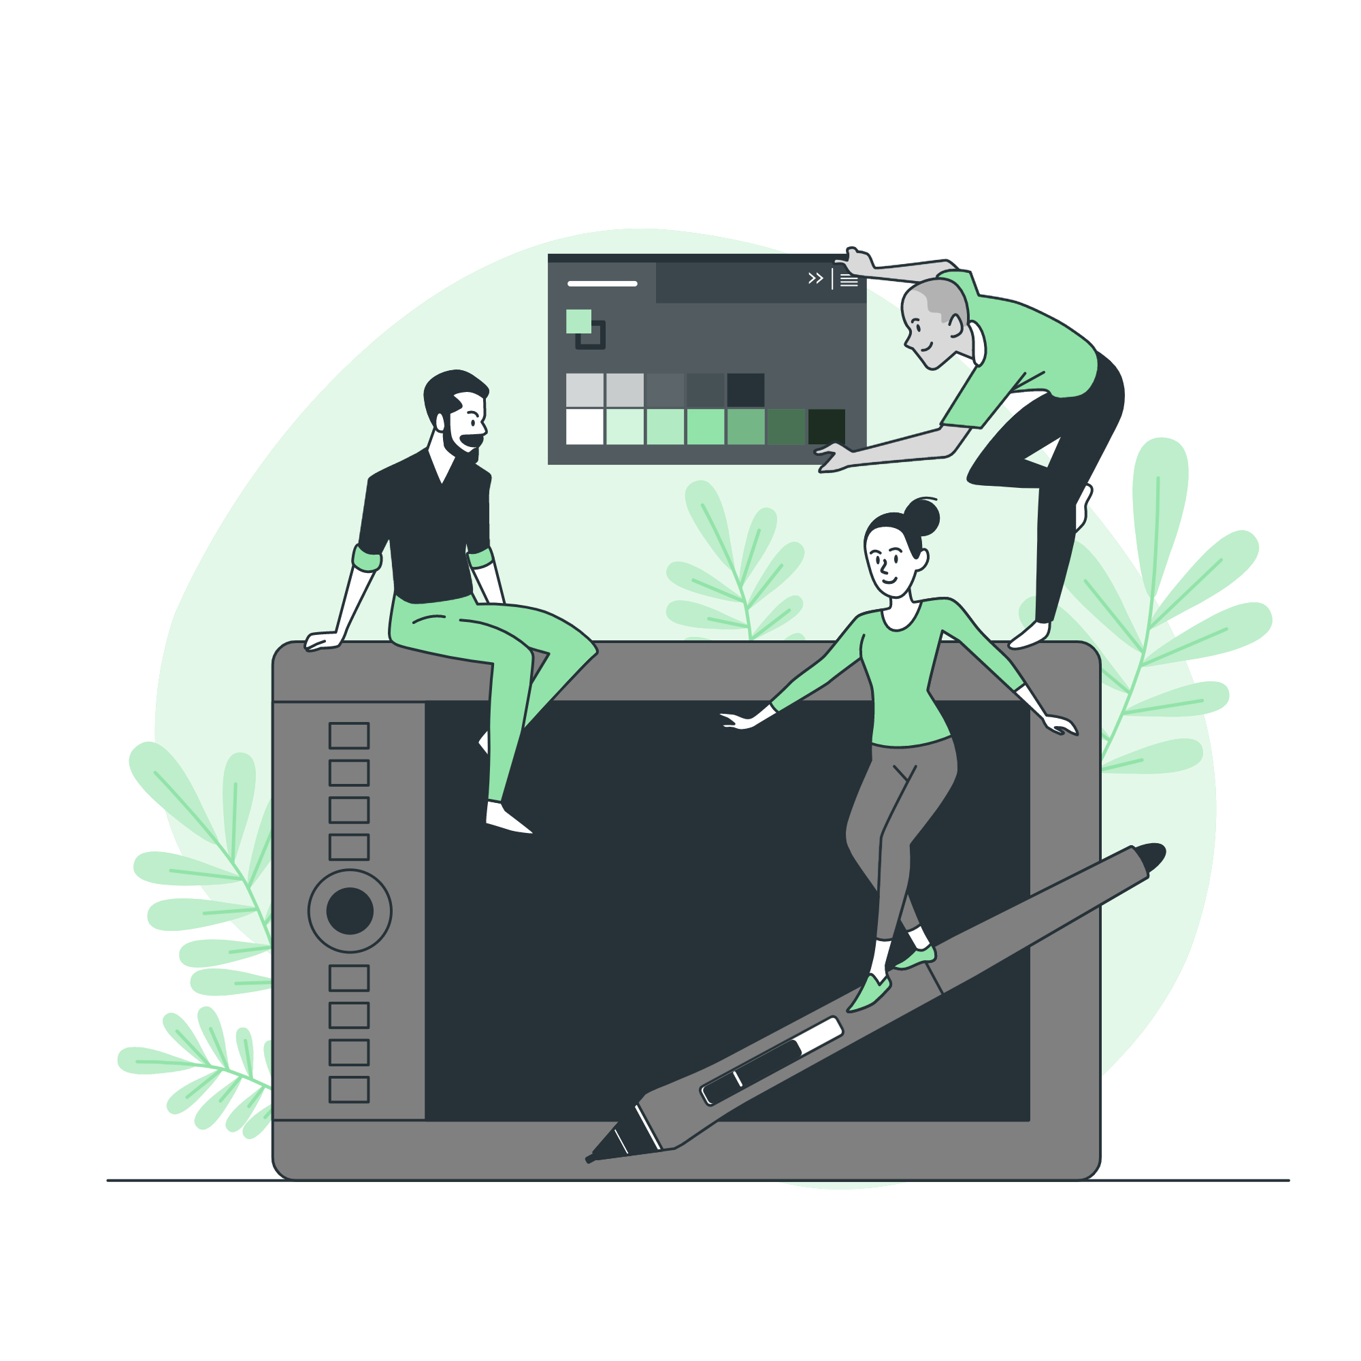



Storyset
Create your Story with our illustrated concepts. Choose the style you like the most, edit its colors, pick the background and layers you want to show and bring them to life with the animator panel! It will boost your presentation. Check out how it works.
Pana
Amico
Bro
Rafiki
Cuate

Slide 30
Use our editable graphic resources...
You can easily resize these resources without losing quality. To change the color, just ungroup the resource and click on the object you want to change. Then, click on the paint bucket and select the color you want. Group the resource again when you’re done. You can also look for more infographics on Slidesgo.

Slide 33
JANUARY
FEBRUARY
MARCH
APRIL
MAY
JUNE
PHASE 1
Task 1
Task 2
PHASE 2
Task 1
Task 2
JANUARY
FEBRUARY
MARCH
APRIL
PHASE 1
Task 1
Task 2

Slide 36
...and our sets of editable icons
You can resize these icons without losing quality.
You can change the stroke and fill color; just select the icon and click on the paint bucket/pen.
In Google Slides, you can also use Flaticon’s extension, allowing you to customize and add even more icons.

Slide 37
Educational Icons
Medical Icons

Slide 38
Business Icons
Teamwork Icons

Slide 39
Help & Support Icons
Avatar Icons

Slide 40
Creative Process Icons
Performing Arts Icons

Slide 41
Nature Icons

Slide 42
SEO & Marketing Icons

Slide 43


